Slide 1



SuperStone Reports
View in Power BI
Last data refresh:
7/26/2024 2:59:53 PM UTC
Downloaded at:
7/26/2024 3:12:45 PM UTC

Slide 2
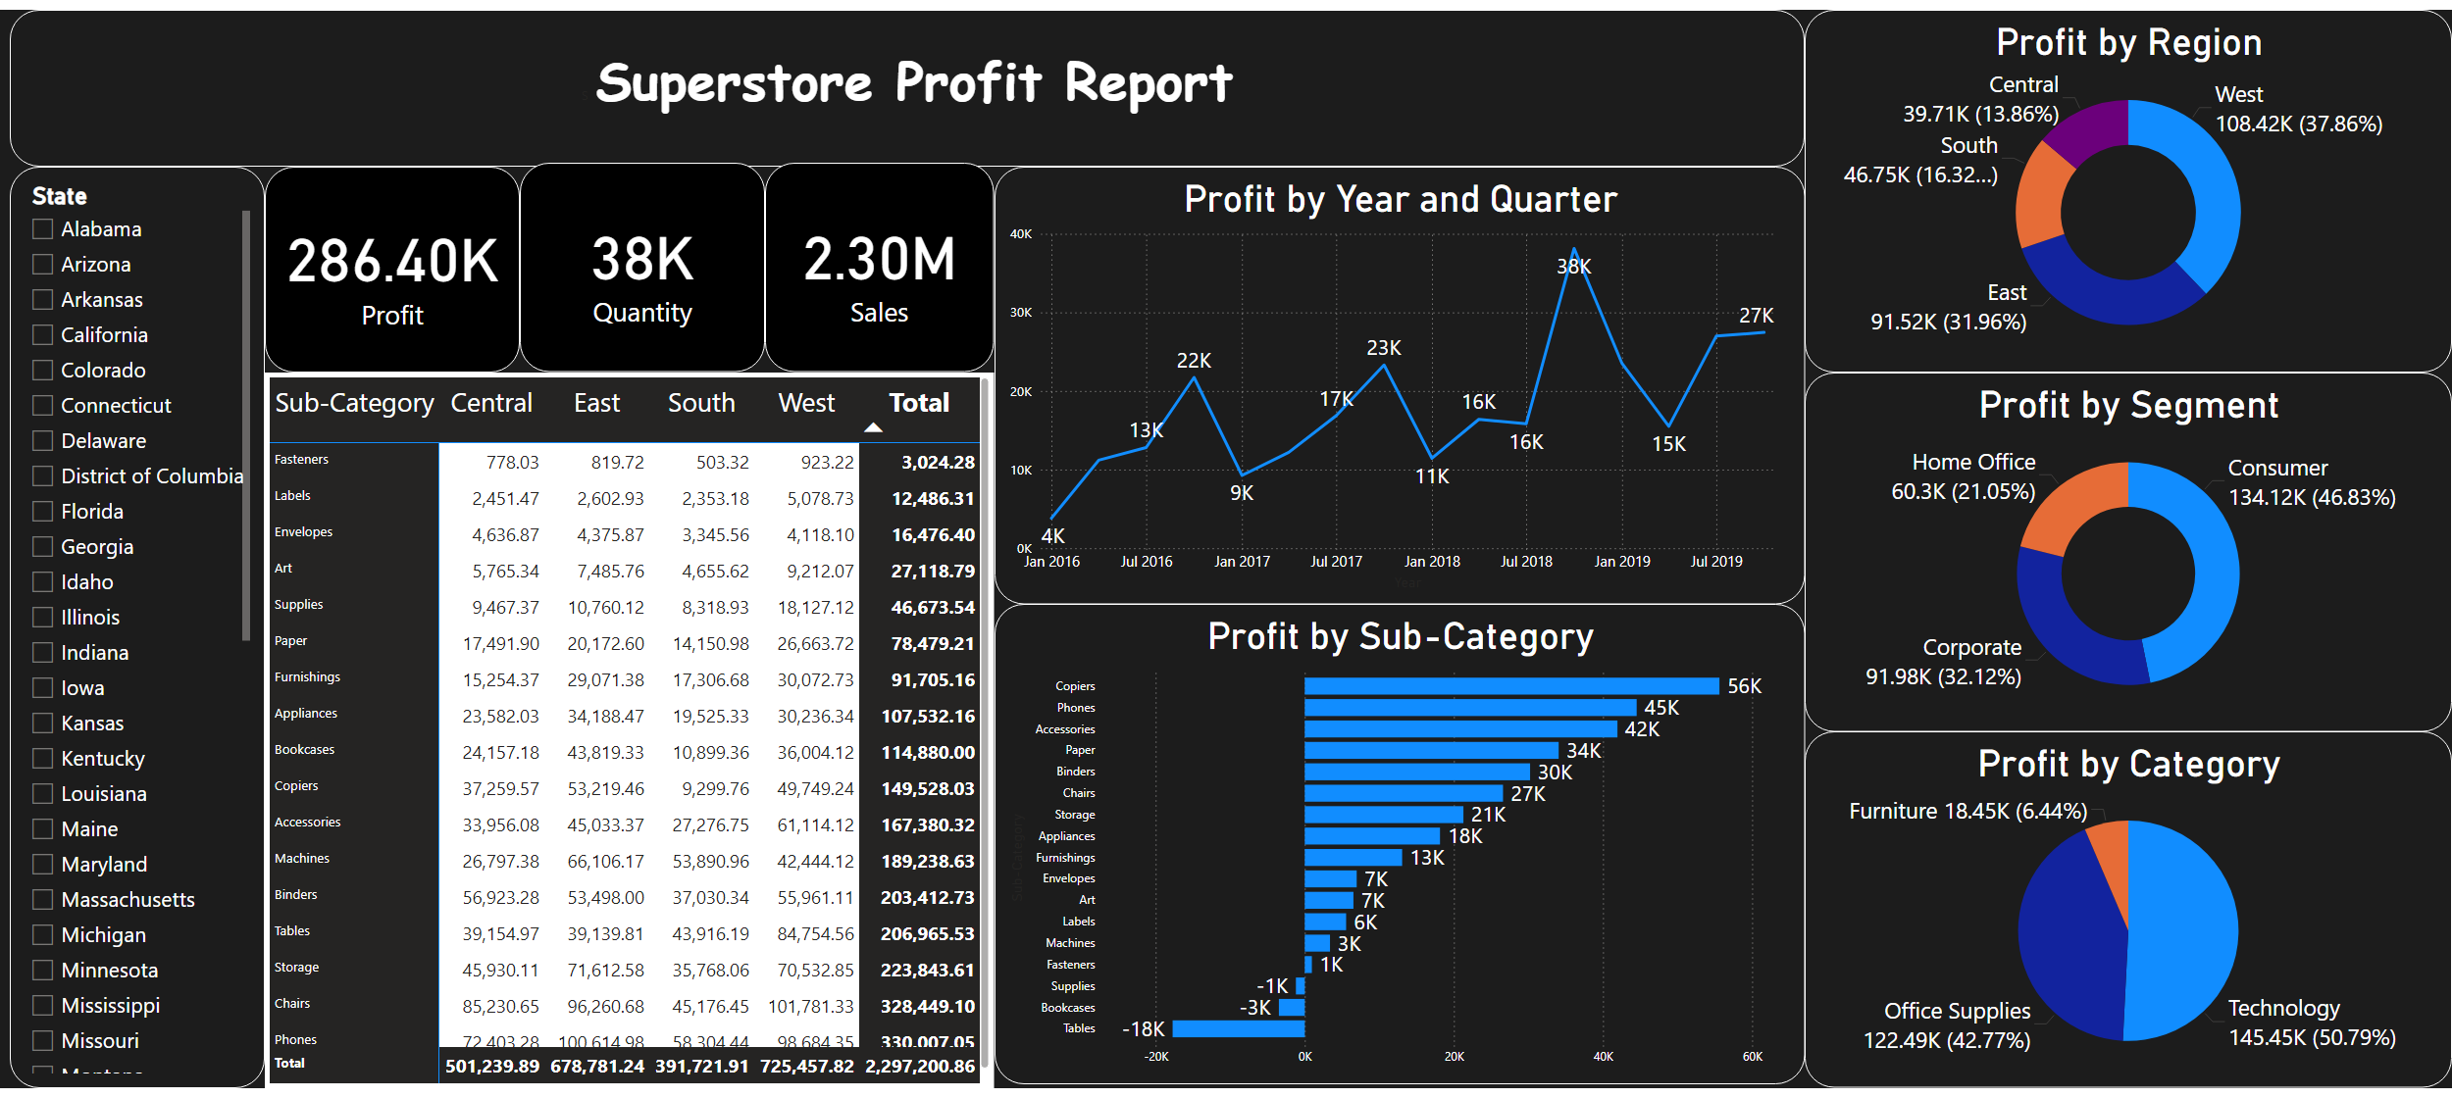
SuperStone Report
Notes:
textbox
No alt text provided
Profit by Category
No alt text provided
Profit by Segment
No alt text provided
Profit by Region
No alt text provided
Profit by Sub-Category
No alt text provided
Profit by Year and Quarter
No alt text provided
pivotTable
No alt text provided
card
No alt text provided
card
No alt text provided
card
No alt text provided
slicer
No alt text provided

Slide 3
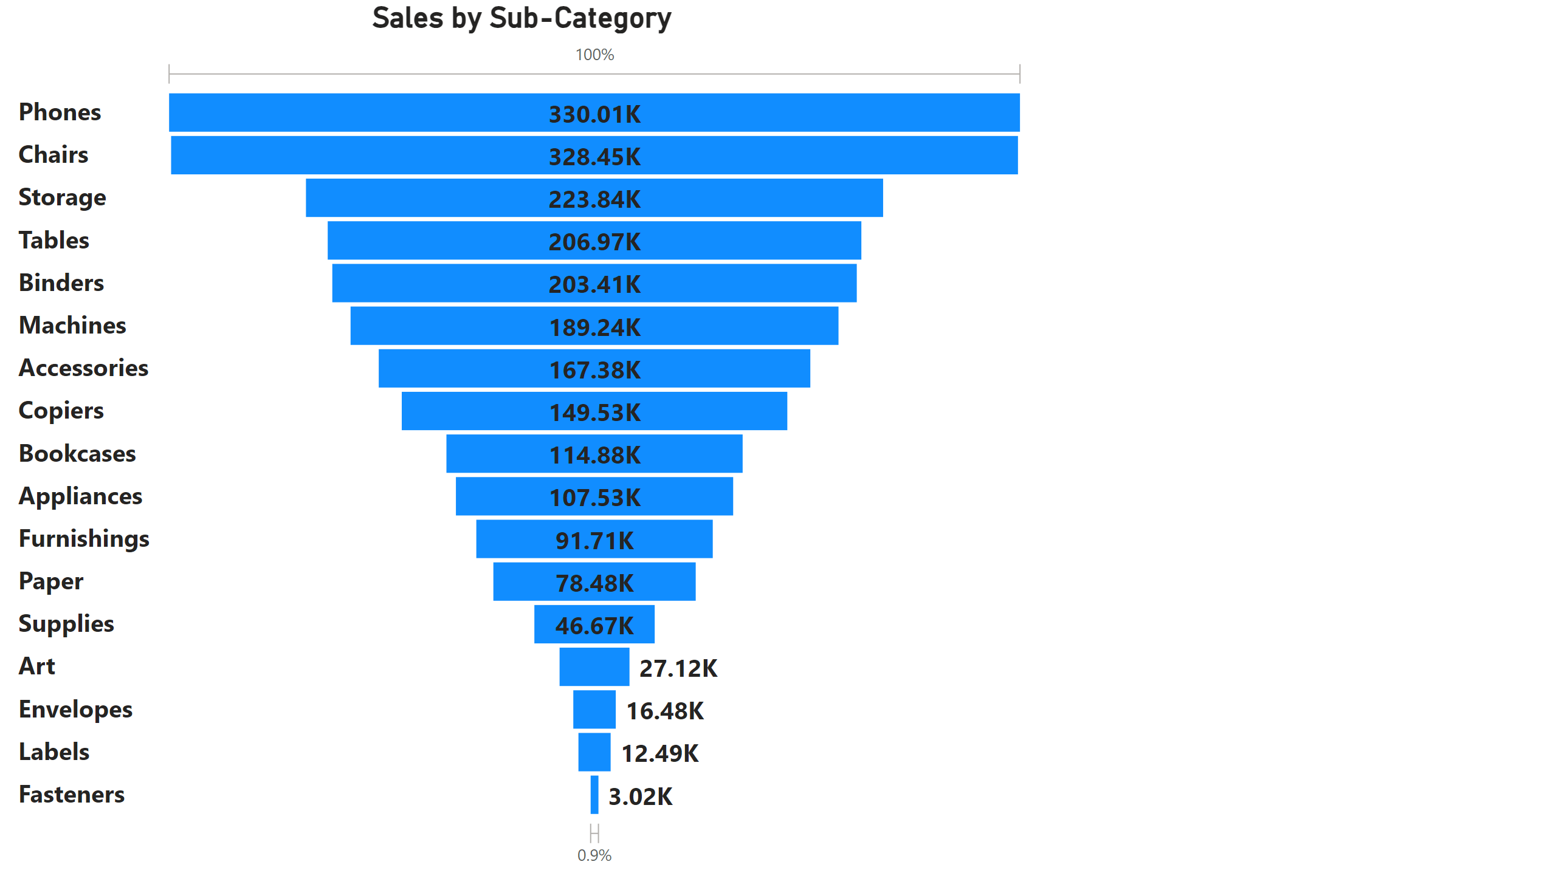
Page 2
Notes:
Sales by Sub-Category
No alt text provided

